Slide 1
DATA 601 –Ethics, Privacy, and More
Felix Gonzalez, P.E. (fgonzale@umbc.edu)
Adjunct Instructor
Division of Professional Studies
Computer Science and Electrical Engineering
University of Maryland Baltimore County

Slide 2


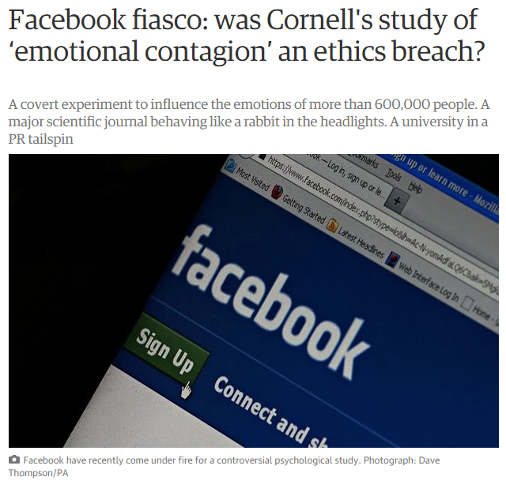
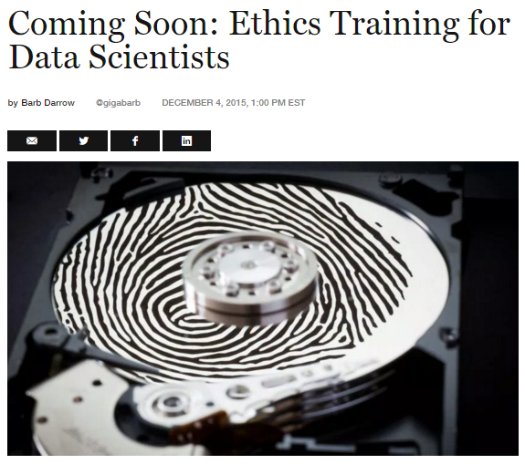
Data Ethics is not a joke!
AI company Anthropic agrees to pay $1.5B to settle lawsuit with authors https://www.nbcnews.com/tech/tech-news/anthropic-settlement-lawsuit-authors-rcna229422
Notes:
Algorithms can do real harm.

Slide 3
The Good, the Bad and the Ugly
Increasing efficiency, effectiveness, and competitiveness:
Data driven companies are more productive
Use of data science make the societies more secure:
Spam emails, fraud detection, terrorist attacks, shootings etc.
Use of data science make the societies more secure
Misinformation:
Using AI for Sign Language Translation
Tom Cruise (Deep Fakes)
Barack Obama (Deep Fakes)

Slide 4
Ethics, Privacy, Legal Issues, and DS
Based on the nature of a project, you might see different issues at different stages,
Initiating the project
Creating the dataset (e.g. surveying)
Cleaning the dataset
Building the model
Presenting the findings
Sharing with others
…

Slide 5
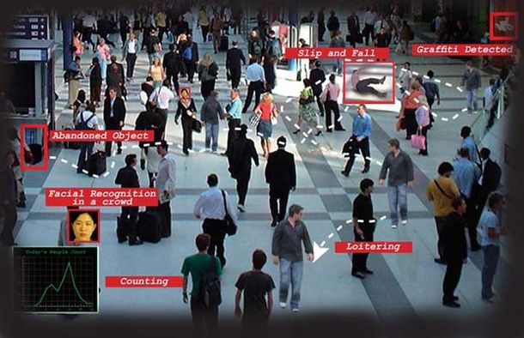
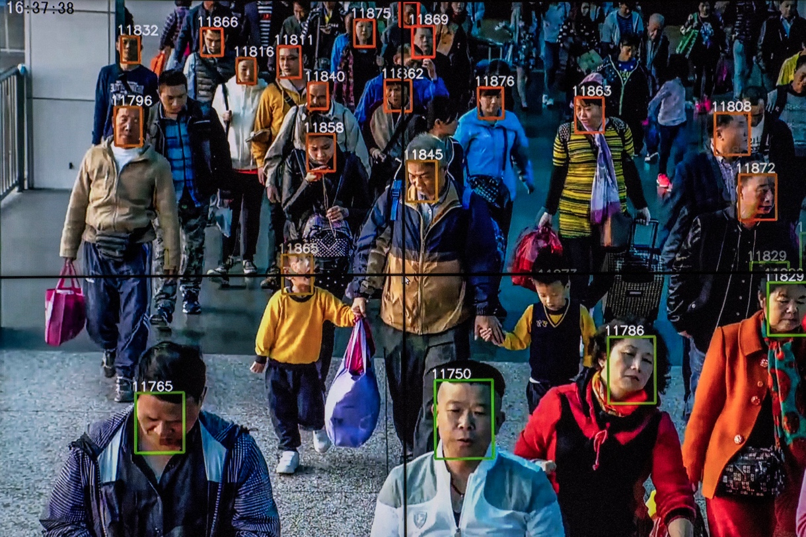
AI Enabled Surveillance
Goal: Catching terrorists, criminals, drug traffickers
Goal: Determining terrorists
What if someone is having a heart attack?
https://www.nytimes.com/2018/07/08/business/china-surveillance-technology.html
Current Use:
Monitoring political activists and minorities
Scoring people
What about misuse?
Notes:
AI system, like any system could be abused, Privacy, Civil Rights, Freedoms, etc.

Slide 6
Targeted Marketing - Customized Pricing
Use of personal data increases the effectiveness of the marketing 3-5 times compared to traditional marketing approaches?
Is it win-win or invasion of privacy?
NYT-Target Case
Different Pricing for the same product?

Slide 7
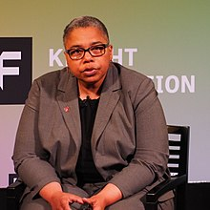
Privacy (Anonymization is the ultimate solution)
Dr. Latanya Arvette Sweeney
In 1997, she identified then MA governor, William Weld, to his medical records using publicly accessible records.
An algorithm can identify 99.98 percent of Americans from almost any available data set with as few as 15 attributes, such as gender, ZIP code or marital status.
Rocher, L., Hendrickx, J.M. & de Montjoye, YA. Estimating the success of re-identifications in incomplete datasets using generative models. Nat Commun 10, 3069 (2019)
https://www.nytimes.com/2019/07/23/health/data-privacy-protection.html

Slide 8
Bias and Fairness
Credit approvals: AI Racial Bias Caused Mortgage Applicants To Be Denied (Link)
Facial recognition: Facial recognition technologies accuracy may vary significantly across various demographic groups (Link)
Criminal justice: A computer program spat out a score predicting the likelihood of each committing a future crime. The algorithm was found to significant racial disparities (Link)
Human resources: resumé screening AI recruiting tool that showed gender bias (Link)
Healthcare services: Racial bias found in health care algorithm (Link)
https://aiethics.princeton.edu/case-studies/case-study-pdfs/

Slide 9
AI’s Invisibility Problem
Diversity is missing from the data or not considered during development of algorithms resulting in inaccurate predictions for AI involving facial/image recognition
Examples of diversity challenges in data science related industries
https://www.forbes.com/sites/carmenniethammer/2020/03/02/ai-bias-could-put-womens-lives-at-riska-challenge-for-regulators
https://www.npr.org/2020/07/02/886544638/we-have-a-black-people-problem-facebook-worker-claims-racial-discrimination

Slide 10
What to do?
Diagnosis by evaluating correlation between explanatory variables (Multicollinearity)
Add more data
Develop curated “gold standard” training data set
Adjust the algorithm
Unbalanced/Skewed Data ➔ Transform
Rare events ➔ Oversample the data (Example)
High frequency events ➔ Under-sample the data (Example)

Slide 11
Various Frameworks and Principles
Examples:
Microsoft, Responsible AI Principles
O’Reilly, Radar; The five Cs of Data Products – O’Reilly, Radar
National Institute of Standards and Technology (NIST), Artificial Intelligence Risk Management Framework
U.S. Government Accountability Office (GAO), Artificial Intelligence: An Accountability Framework for Federal Agencies and Other Entities
Notes:
The U.S. Federal Government AI Frameworks and Standards provide guidance on questions that need to be asked when developing systems that use AI and includes industry best practices and Ethic considerations.

Slide 12
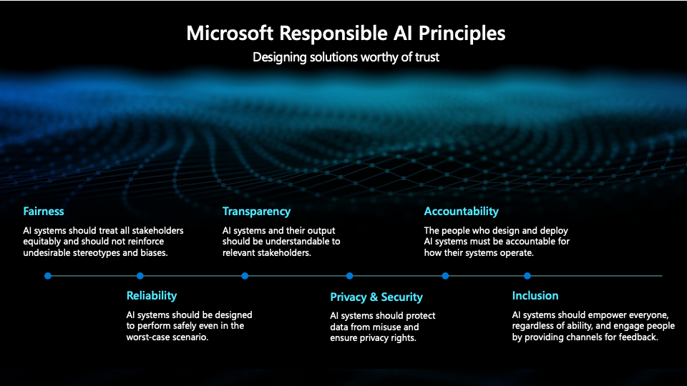

Slide 13
O’Reilly Radar Five C’s of Data Products
Consent: A clear appreciation and understanding of the facts, implications, and consequences of an action
Clarity: Who is going to use the data, when your data will be used, how long it will be kept, whether it will be shared with 3rd parties?)
Consistency and Trust: How will be data stored? What will happen if stolen? Will company choose values when it comes to chose between values and money?
Control and Transparency: Who has the control over the data? Will the participants be able to change/remove their data?
Consequences: Unknown unknowns: whether a company invest on thinking possible consequences?
Source: The five Cs – O’Reilly (oreilly.com)

Slide 14
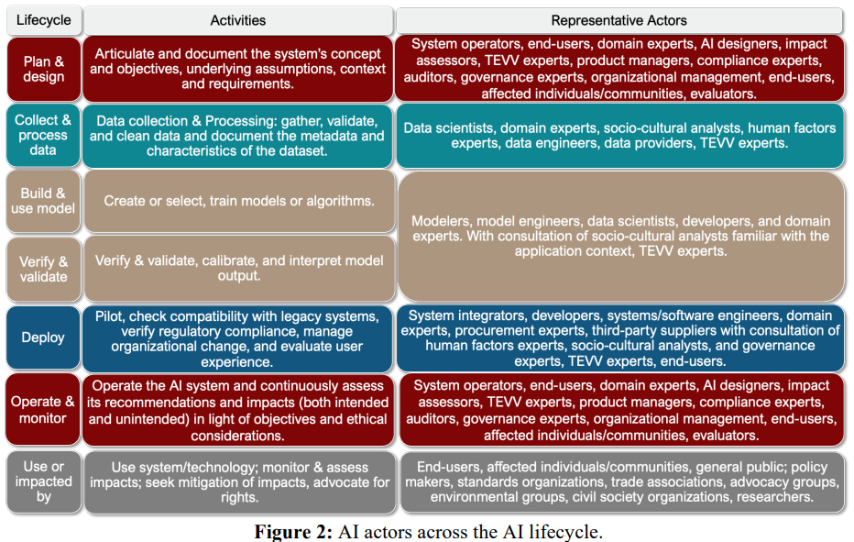
National Institute of Standards and Technology
NIST, Artificial Intelligence Risk Management Framework.
Notes:
Currently in draft, accepting comments and conducting public workshops.
Developed in coordination with public, industry, state and federal government and other entities and organizations.
Lays out principles and considerations.

Slide 15
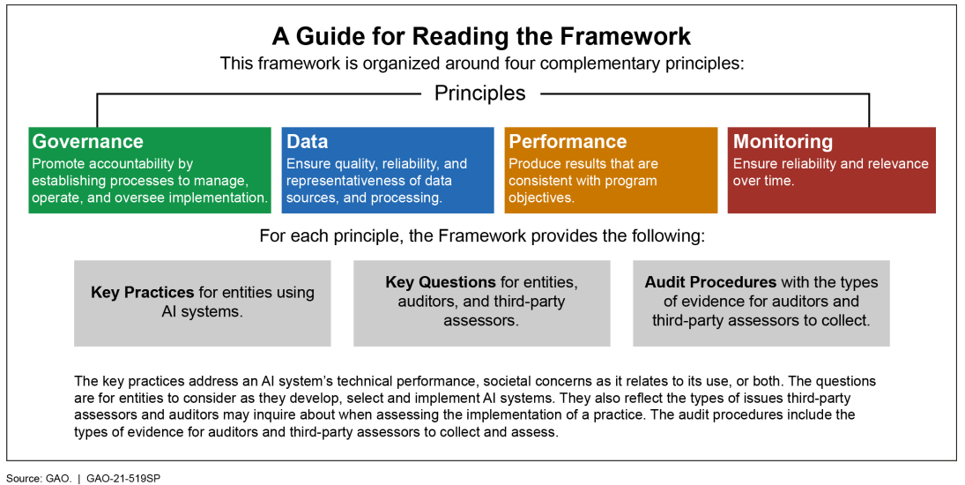
U.S. Government Accountability Office
U.S. Government Accountability Office (GAO), Artificial Intelligence: An Accountability Framework for Federal Agencies and Other Entities.

Slide 16
Minimum Practices for Data Science Projects
Documentation: promote transparency and trust
Have we evaluated and documented our main goal, objective, roles and responsibilities, design, development, capabilities, limitations, data sources, methods for assessment, model specifications and parameters, performance evaluation, risks, and controls and barriers that are in place to prevent or mitigate risks?
Have we conducted an AI impact or risk assessment?
Risks:
Have we studied and understood possible sources of bias in our data? (Note the effect of data bias in supervised and unsupervised methods is different)
Have we tested our training data to ensure it is fair and representative of use cases?
Have we identified and have understanding of potential bias, inequities, societal concerns, and other risks?
Have we tested for fairness with respect to different user groups?
Have we tested for disparate error rates among different user groups?
Have we listed how this technology can be attacked or abused?
Is our system reliable, reproducible, traceable, and with transparent and explainable outputs (as permitted by the system)?

Slide 17
Minimum Practices, Cont.
Controls and Barriers:
Do we have a mechanism for redress if people are harmed by the results?
Do we test and monitor for model drift to ensure our software remains fair over time?
Do we monitor and provide oversight to the system?
Do we identify who is accountable for the system?
Stakeholders:
Multi-disciplinary team: Does our team reflect diversity of opinions, backgrounds, and kinds of thought?
Do we have a process to capture feedback from stakeholders (e.g., domain experts, industry, public, etc.)?
User Consent:
What kind of user consent do we need to collect?
Use the data and how to collect such consent?
Have we explained clearly what users are consenting to?
Security and Privacy
Can we shut down this software in production if it is behaving badly?
Do we have a plan to protect and secure user data?

Slide 18
Other Examples and References
Top 9 Ethical Dilemmas of AI and How to Navigate Them in 2022 (https://research.aimultiple.com/ai-ethics/)
Jumpstart Article on "AI Gone Wrong 5 Biggest AI Failures of All Time" https://www.jumpstartmag.com/ai-gone-wrong-5-biggest-ai-failures-of-all-time/
Rogan grills Zuckerberg on how Facebook moderates’ controversial content (https://www.youtube.com/watch?v=irCFLEVUuIo)
Notes:
Mr. Zuckerberg provides a good example on algorithms used to catch bad behaviors in the platform.
(1) In one scenario we may have an algorithm that labels bad guys but at the same time we may mislabel a few good guys in the process.
(2) In the other scenario we may want to make sure we keep at a minimum mislabeling of good guys as bad guys but we may have to let a few bad guys go by?
This is a classification problem dilemma and as a data scientist your job is to work with your stakeholders to identify which are acceptable and unacceptable situations for your problem.

Slide 19
Ethical Principles of Data Visualization
Well-designed charts are empowering.
They can also deceive viewers regardless of whether they are designed with ill-intent or not.
Data visualization has ethical consequences
Ethical thinking is not only about intentions, but also about consequences.
Need to explicitly consider ethical principles when creating and distributing visualizations.
Transparency
Integrity
Accountability

Slide 20
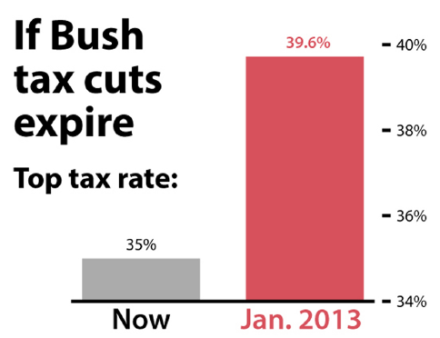
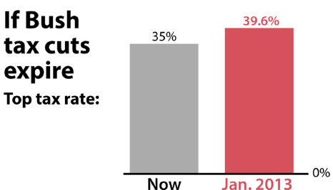
Don’t
It should have been
Notes:
Fox News, 2012

Slide 21
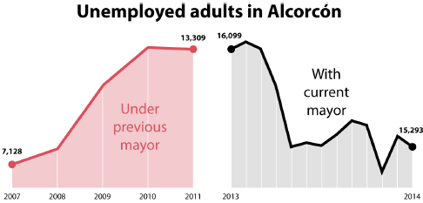
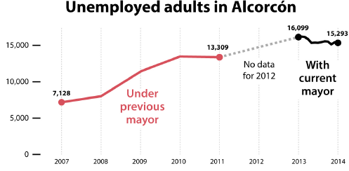
Don’t
Created by the Spanish city of Alcorcon in 2014 to celebrate the success of the current Mayor in increasing employment.
Distorted both vertical and horizontal scales.

Slide 22
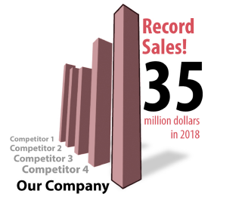
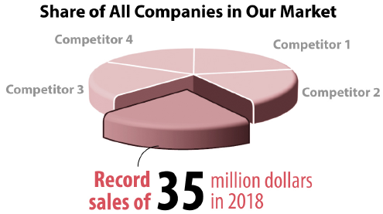
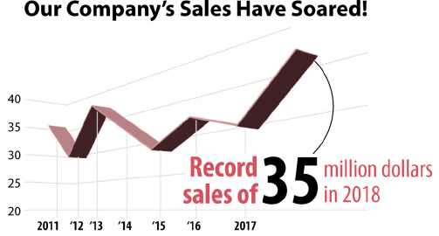
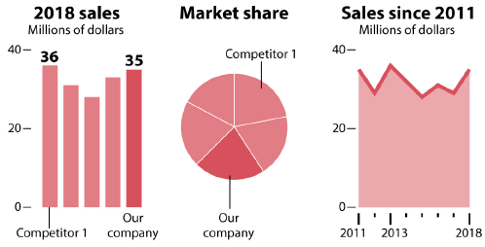
Don’t

Slide 23
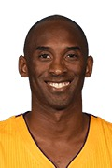


Was Kobe a ball hog?
In the 2009-2010 season, Kobe made 9.8 shots per game and had 5.0 assists per game, on average.
10
10
5
5
Made Shots
Assists
Made Shots
Assists
Notes:
This pictograph is misleading. While the number of ‘made shots’ is only double the ‘assists’ per game, the two-dimensional ball figure makes the made shots appear several times as big.

Slide 24
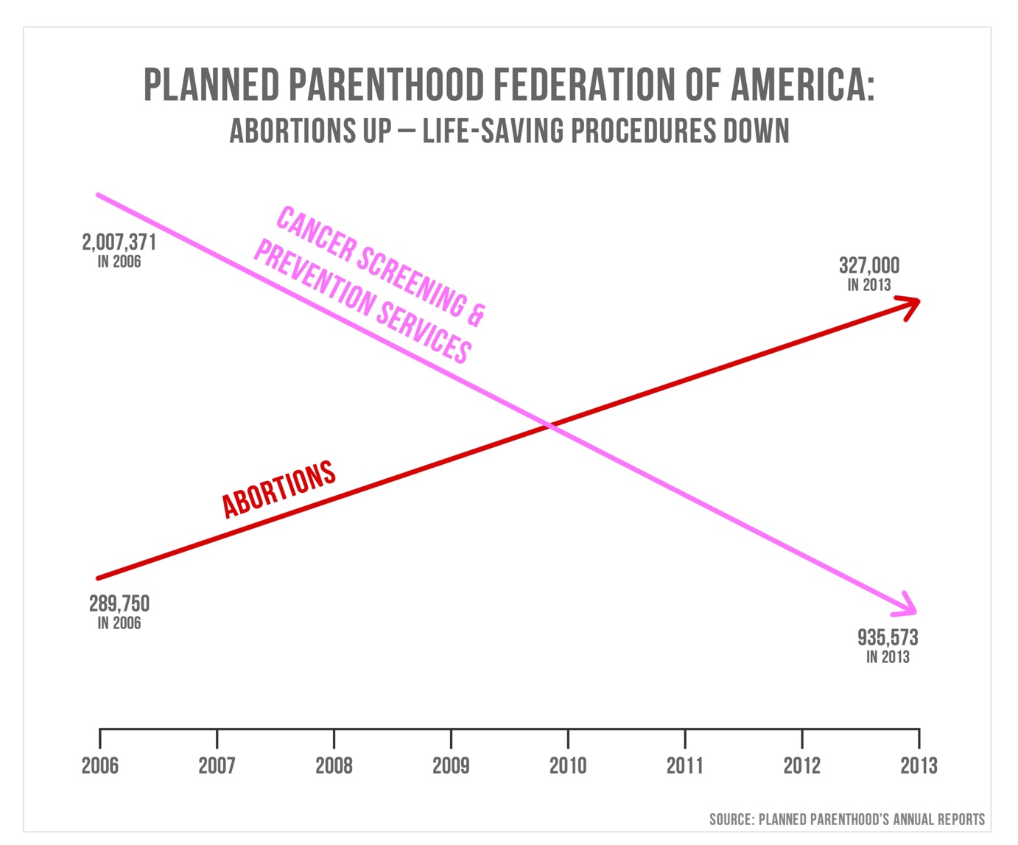
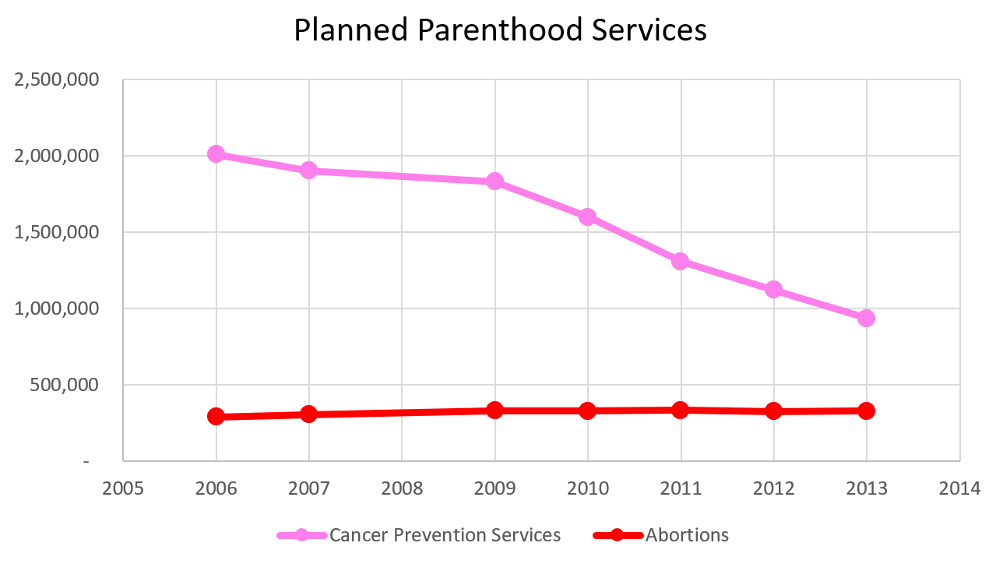

Slide 25
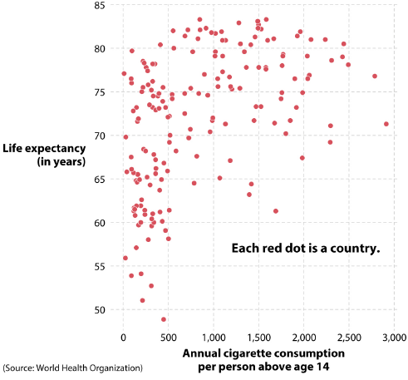
Correlation is not equal to causation
The more cigarettes we consume, the longer we live!!!

Slide 26
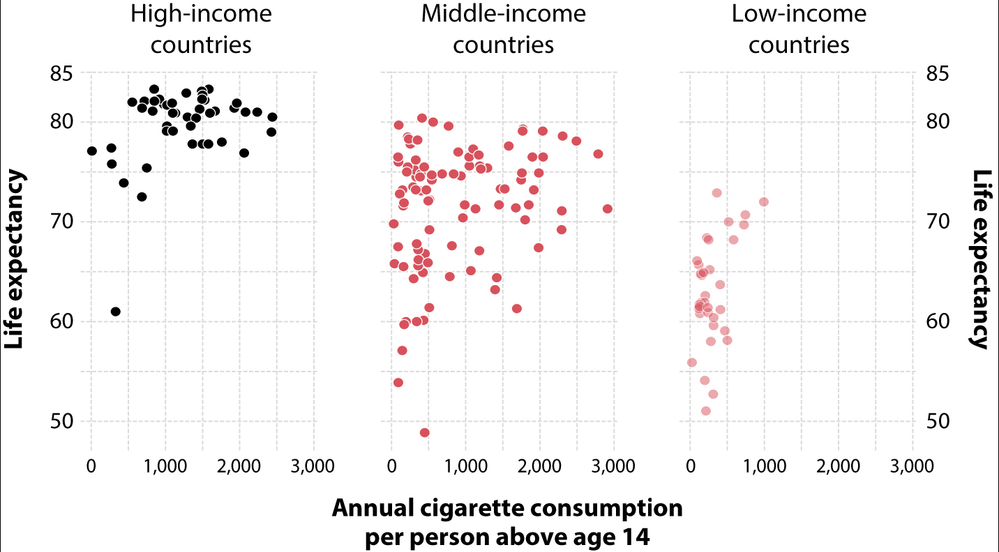
Correlation is not equal to causation

Slide 27
Before You Create a Chart
Ask
Who is my audience?
What questions do they have?
What answers am I finding for them?
What am I trying to say?
What other questions will my visualization inspire or what conversations may result?

Slide 28
Data Visualization Best Practices
Identify your target audience
Make sure your data is clean
Select the right chart
Label your chart effectively
Emphasize the important points
Format your chart for accessibility
Make use of color
Ensure your data is readable in any format
Ask for feedback

Slide 29
Questions?

Slide 30
Additional Slides

Slide 31
Survey Design: 7-Step Process
Step 1: Literature Review
Step 2: Interview Experts & Create Focus Groups from Target Population
Step 3: Synthesize
Step 4: Develop Items
Step 5: Expert Validation
Step 6: Cognitive Interviewing
Step 7: Pilot Test

Slide 32
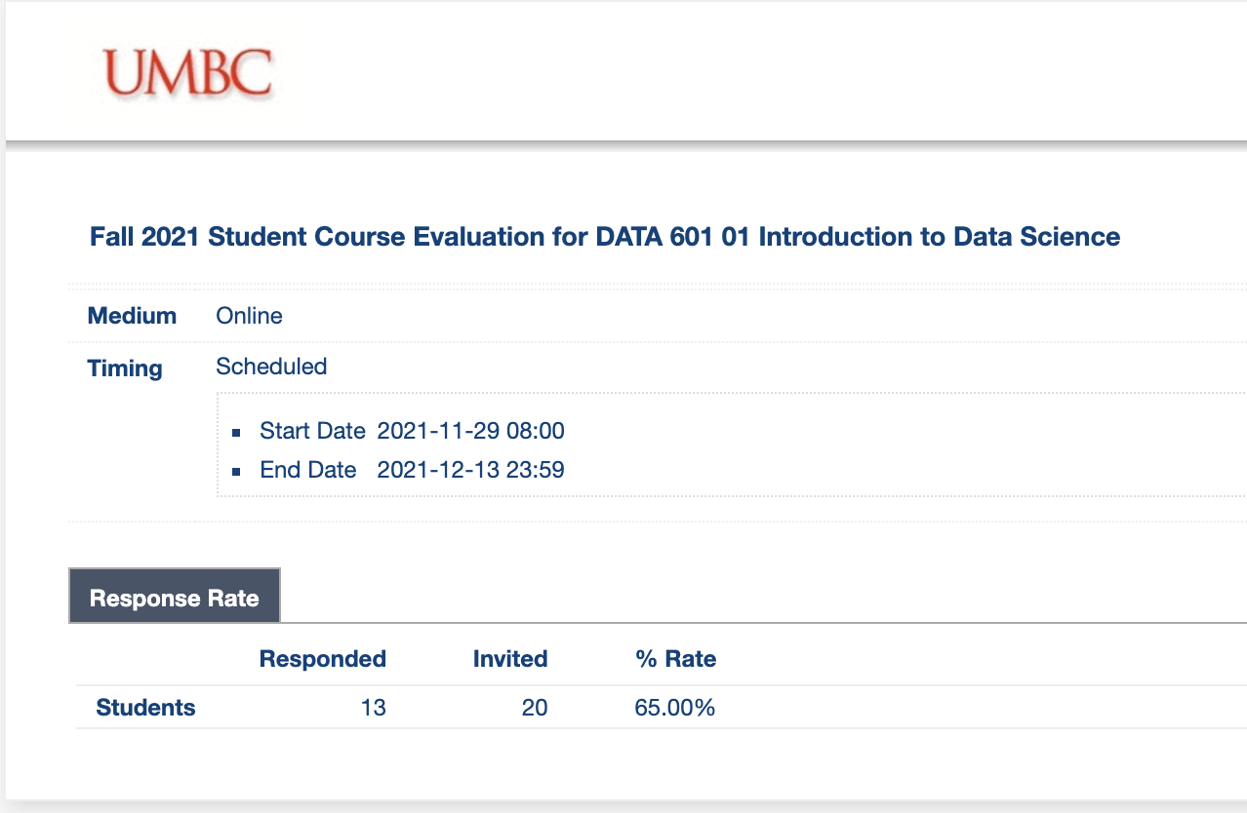
Survey Design is Almost an Art
Population matters
Females more likely to respond than males
Younger generation less likely to join
Questions matter ➔ Next Slides

Slide 33
Survey Design: Questions Matter
A seemingly straight forward question can lead to inaccurate data
The global economy is the most important issue in the world today.
strongly disagree | disagree | neither agree nor disagree | agree | strongly agree
Now look at the revised version
How important is the issue of the global economy in the world today?
not at all Important | slightly important | moderately important | quite important | extremely important

Slide 34
Survey Design: Questions Matter
Providing a reason…
Q8) As some of you may know, the university is debating whether to move some parts of the university to a new section of campus in Rockville. Do you think the university should move to Rockville?
Q8) As some of you may know, the university is debating whether to move some parts of the university to a new section of campus in Rockville. Do you think the university should move to Rockville so that the school can have more space?
Yes = 12.5%
Yes = 55.6%
Giving a reason will improve the extent to which people agree with you, and impact the accuracy of your survey

Slide 35
Questions?

